Slide 1
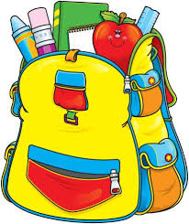
First Grade School Supply List
24 Ticonderoga pencils
2 pink block erasers
24 pack of crayons
2 large glue sticks
l backpack - labeled
l pair of scissors - Fiskars brand
l plastic pencil box - No cloth material
l box of Ziploc bags
Boys : quart size Girls : gallon size
Mrs. Lapine | Mrs. McPartland | Mrs. Prosak | Mrs. Prince
Colored pencils | Markers 8 pack 4 Expo Dry Erase Markers- Fine Tip, Black ONLY (this brand only please) | 4 Expo Dry Erase Markers- Fine Tip, Black ONLY (this brand only please) | 4 Expo Dry Erase Markers- Fine Tip, Black ONLY (this brand only please)

